Slide 1
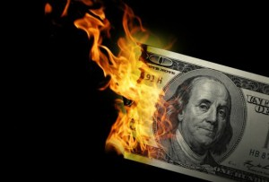
CS1951 L
Blockchains & Cryptocurrencies
Fall 2025
Lecture 20
Proof-of-Stake in
Algorand & Ethereum
Maurice Herlihy
Brown University

Slide 2
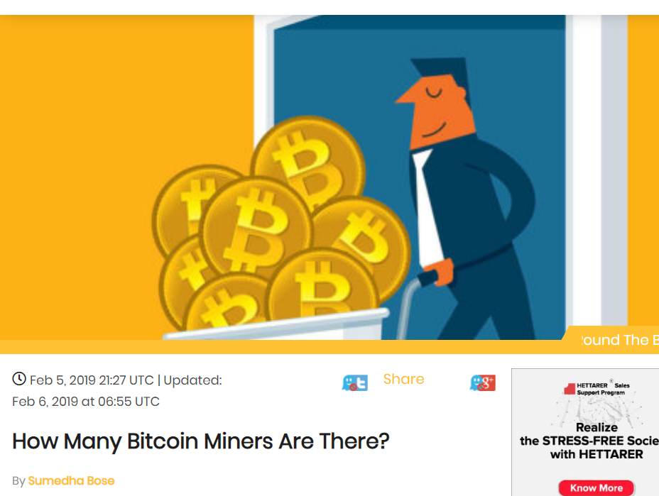
Bitcoin (PoW) scales well in number of miners
(not so much along other dimensions)
But much of this work is wasted energy …

Slide 3
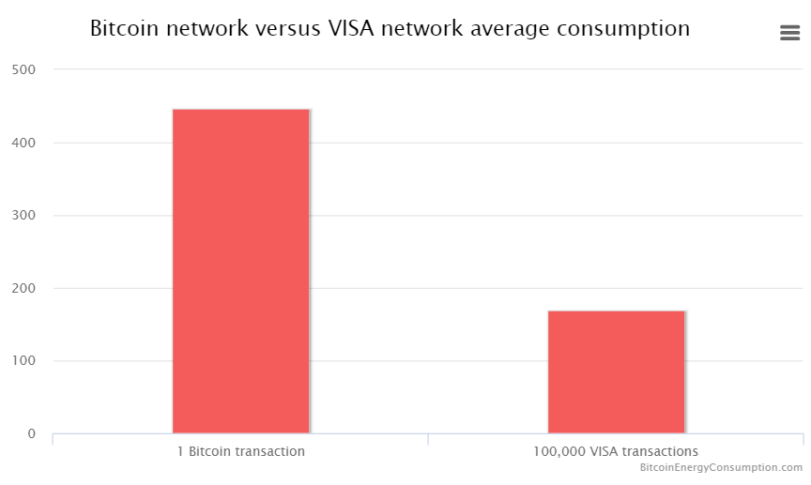
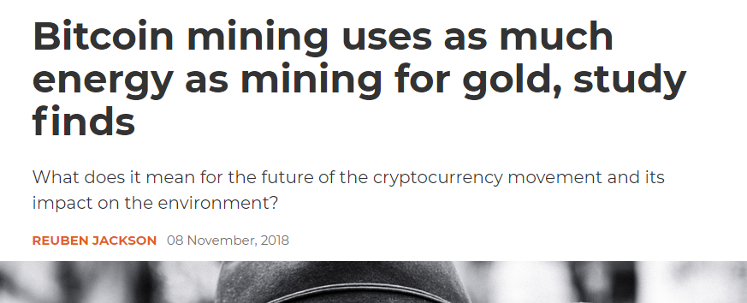
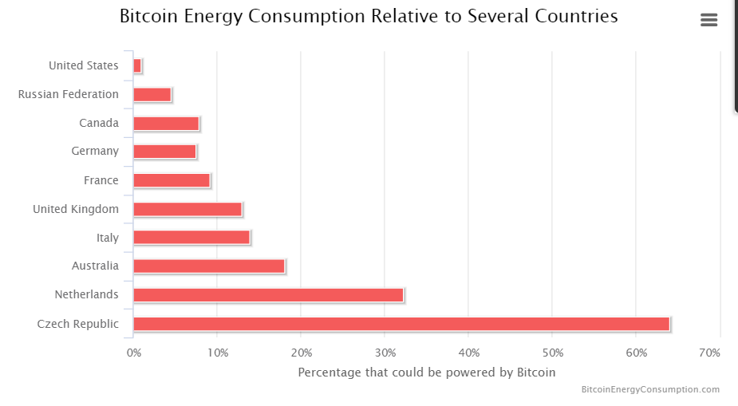
PoW is Wasteful

Slide 4
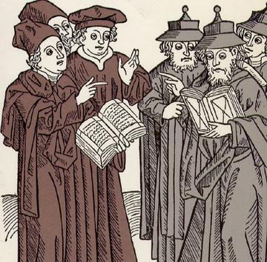
Our block is permanently on the chain!
We are not so sure!
Finality?

Slide 5

Finality
Finality delay inherent in PoW
Make puzzle harder?
More time between blocks …
Make puzzle easier?
More forks, longer confirmation…

Slide 6

PoW encourages Centralization
High barriers to entry
Mining hardware expensive
Only “deep pockets” can compete
Poorer miners forced into centralized pools

Slide 7
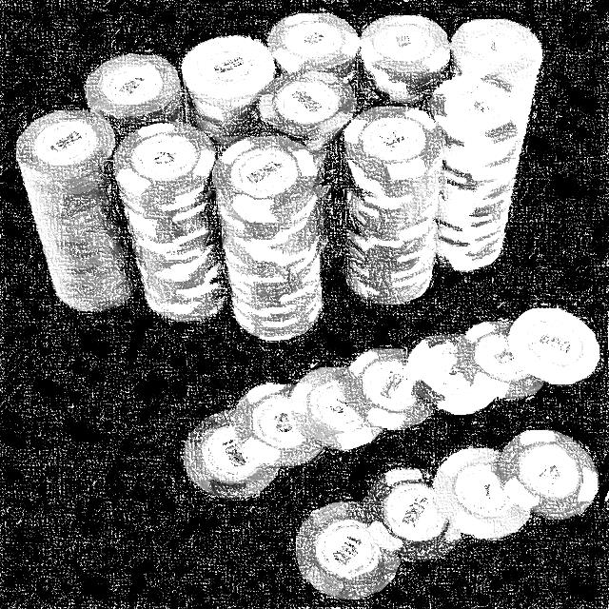
Proof of Stake
One coin, one vote
Stakeholders motivated to be honest
Decentralized: lower barrier to entry
Invest in coins, not mining hardware
No incentive for centralized pools

Slide 8
Proof of Stake
Who votes?
Everyone? Not scalable
Randomly-selected committee
What do they vote on?
(Byzantine) Consensus

Slide 9

Customized BFT protocol
Randomly select committee
Weighted by stake
Reselect on each round

Slide 10
With high probability, all agree on sequence of transactions
Safety: if one honest user accepts a txn, all eventually do
Liveness: under network assumptions

Slide 11
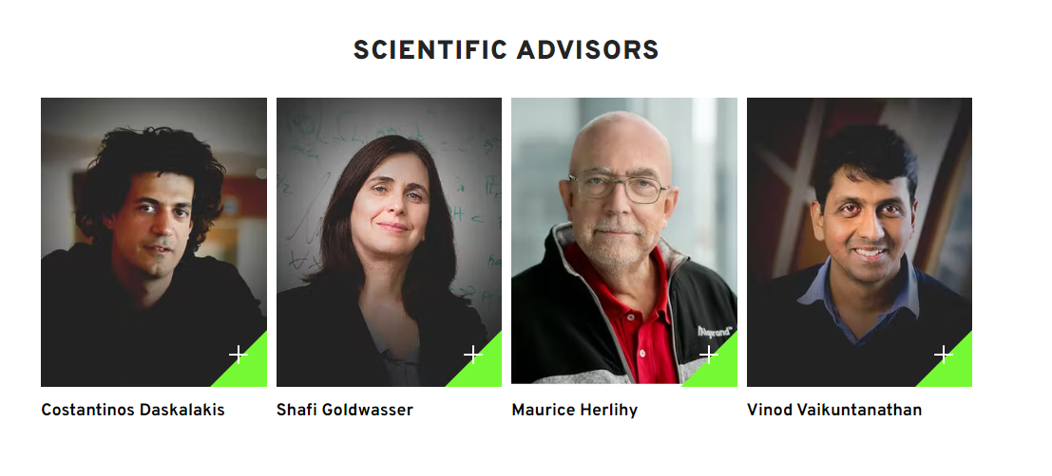
Full Disclosure

Slide 12

I can participate and hold money
But I cannot afford more than some h < 1/ 3
I can corrupt targeted users
But I cannot corrupt > 1/3 of users
Algorand Adversary

Slide 13
Weak Synchrony Model
Network can be controlled by adversary for a long but bounded time (~1 day?)
But then network always becomes synchronous for reasonably long period (~1 day?)
known Δ
Notes:
In asynchronous models, processes take steps at any rate.
Asynchronous comes from Greek: a (not) + synchronous (at the same time).
Synchronous comes from Greek: syn = together, chronos = time.

Slide 14
Loosely Synchronized Clocks
Like NTP protocol
1:13
Honest users recover at almost same time
1:14
Recovery requires clocks not too far apart
1:13
Notes:
In asynchronous models, processes take steps at any rate.
Asynchronous comes from Greek: a (not) + synchronous (at the same time).
Synchronous comes from Greek: syn = together, chronos = time.

Slide 15
Weak Synchrony Assumption
Period of length b
Synchronous period of length s

Slide 16
Strong Synchrony Assumption
Liveness
Most honest users (~95%) send messages
received by most honest users (~95%)
Within a known time bound

Slide 17
Safety vs Liveness
While network is synchronous,
Algorand is live: all transactions complete
While network is asynchronous,
Algorand is safe: no incorrect behavior

Slide 18
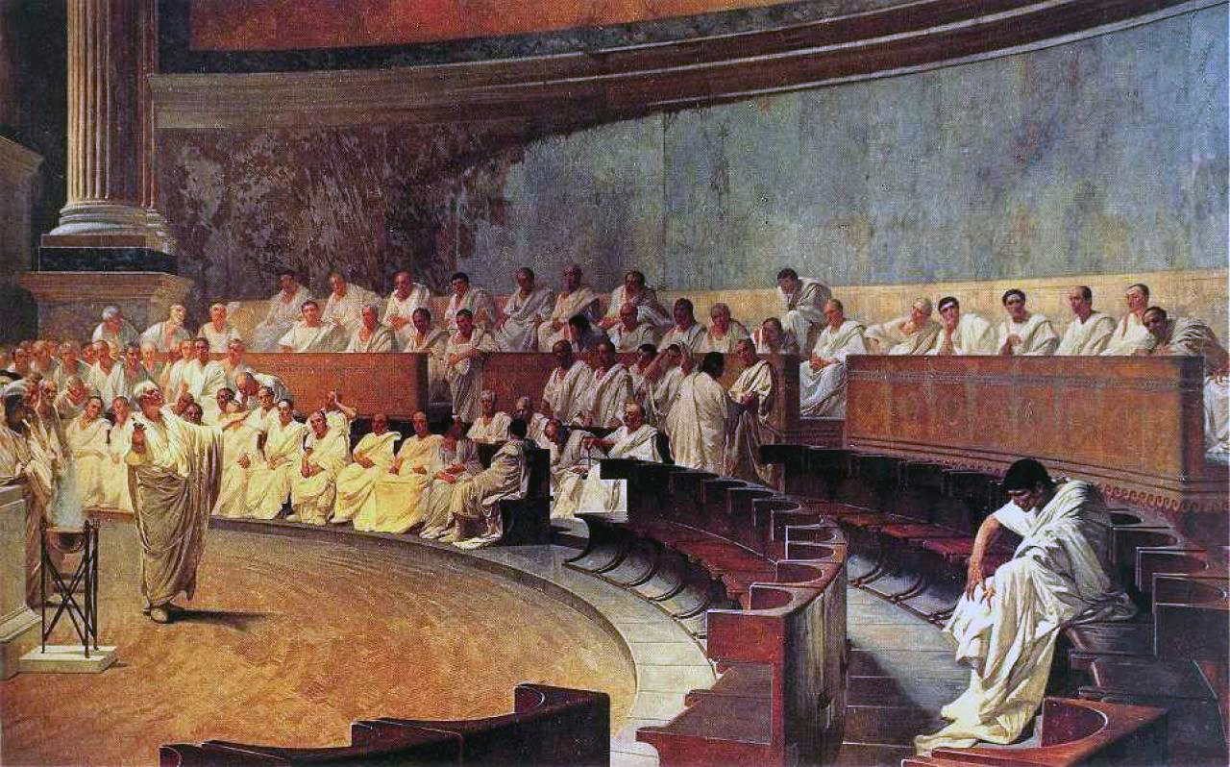
Scalability: Elect a Committee
We, a small group,
make quick decisions
on behalf of the masses
Just need to ensure that committee selection is not corrupted
Notes:
https://www.google.com/url?sa=i&source=images&cd=&cad=rja&uact=8&ved=2ahUKEwjttr2vzbffAhXMMd8KHTAnBQQQjRx6BAgBEAU&url=https%3A%2F%2Fen.wikipedia.org%2Fwiki%2FSenate_of_the_Roman_Republic&psig=AOvVaw0Usp73ybMrfbGbhSGMcVY7&ust=1545711263831143

Slide 19
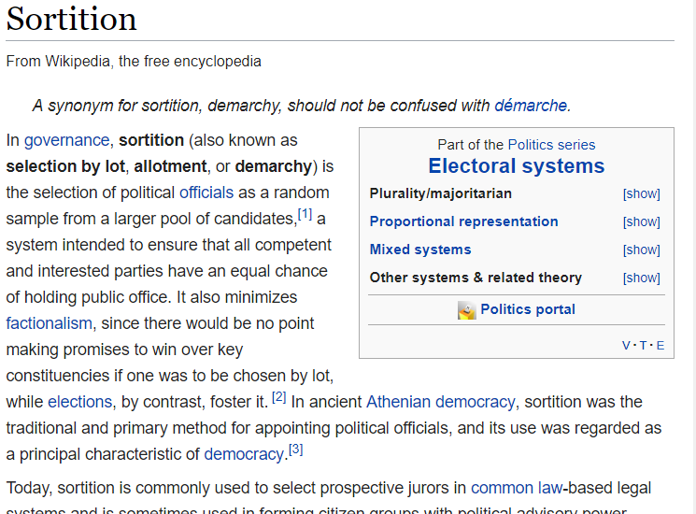
“the selection of political officials as a random sample from a larger pool of candidates”
“system intended to ensure that all competent and interested parties have an equal chance of holding public office”
“In ancient Athenian democracy, sortition was the traditional and primary method for appointing political officials, and its use was regarded as a principal characteristic of democracy”

Slide 20
Committee
7BOQ…
R45F…
7BOQ…
R45F…
I propose R45F…
R45F…
R45F…
R45F…
I propose 7BOQ…
Leaders
Validators

Slide 21
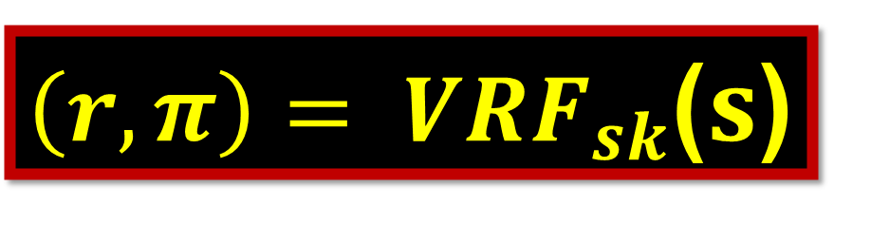
Verifiable Random Function
Here is a pseudorandom value r and a proof π of correctness & authenticity
Here is my secret key sk and a seed s
Sk,s
r, π
Alice
VRF
$\left(r,π\right)= {VRF}_{sk}$($s$)

Slide 22
Verifiable Random Function
Here is my pseudorandom value r and a proof π of correctness & authenticity
Your r looks random to me
Alice
Bob

Slide 23
Verifiable Random Function
Here is my pseudorandom value r and a proof π of correctness & authenticity
I believe you because I checked π
r, π
Alice
Bob

Slide 24
Assume Equal Weights

Slide 25
VRF is a Lottery
A leader!
You get a low number
sk

Slide 26
VRF is a Lottery
sk
Committee member!
You get a medium number
sk
validator

Slide 27
VRF is a Lottery
sk
sk
validator
Standing by …
You get a high number
sk

Slide 28
VRF is a Lottery
Leaders: not too many, ideally 1
Selection probability ~ account balance
Committee: not too big (inefficient)
validator
Committee: not too small (insecure)
Adversary cannot predict

Slide 29
At each round: seed revealed
Each party secretly checks: am I chosen?
No one else knows …
Adversary does not know whom to attack
New committee chosen each round

Slide 30
What about “one coin, one vote”?

Slide 31



One Million Algos!
sk
sk
sk
One VRF call for each coin?
sk
sk
sk
sk
sk
sk
sk
sk
sk
sk
sk
sk
sk

Slide 32
One Million Algos!
sk
sk
sk
Nope
sk
sk
sk
sk
sk
sk
sk
sk
sk
sk
sk
sk
sk

Slide 33
Weights to Votes
I own w coins
VRF
How many votes do I get?

Slide 34
Normalize r to unit interval
My r / 2^{m} ∈ [0,1]
Here is your r ∈ [0,2^{m}]
sk

Slide 35
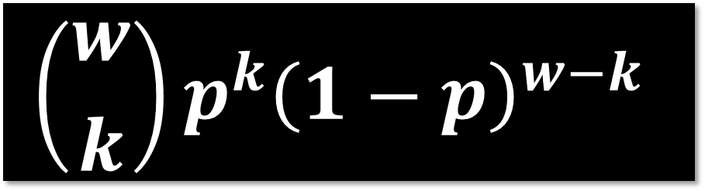
Probability exactly k out of w coins chosen to vote
Number of ways this can happen
$$\left({w \atop k}\right)p^{k}{\left(1−p\right)}^{w−k}$$
Prob k chosen
Prob w-k not chosen

Slide 36
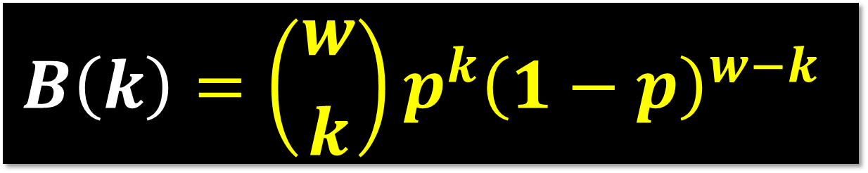
Shorthand
$$B\left(k\right)=\left({w \atop k}\right)p^{k}{\left(1−p\right)}^{w−k}$$

Slide 37




Probabilities sum to 1
0
1
…
$$B\left(0\right)$$
$$B\left(1\right)$$
$$B\left(k−1\right)$$
$$B\left(k\right)$$

Slide 38




Probabilities sum to 1
The probability of VRF landing in this interval …
0
1
…
$$B\left(0\right)$$
$$B\left(1\right)$$
$$B\left(k−1\right)$$
$$B\left(k\right)$$
Is the probability of choosing exactly k out of w coins

Slide 39




1 VRF for million algos
My r / 2^{m} ∈ [0,1]
Here is your r ∈ [0,2^{m}]
I have k votes!
sk
0
1
…
$$B\left(0\right)$$
$$B\left(1\right)$$
$$B\left(k−1\right)$$
$$B\left(k\right)$$

Slide 40
1 VRF for million algos
π is proof I have k votes!
Here is your proof π
sk
0
1
…
$$B\left(0\right)$$
$$B\left(1\right)$$
$$B\left(k−1\right)$$
$$B\left(k\right)$$

Slide 41
But what do they vote on?

Slide 42



Consensus: Each Thread has a Private Input

Slide 43
They Agree on One Thread’s Input

Slide 44

Crash Failures

Slide 45
Crash Failures
Notes:
A crash failure can cause one party to send a value to some parties but not others.

Slide 46

Byzantine Failures
Notes:
A Byzantine party can lie, sending different values to different peers

Slide 47




He said, She said …
???
Notes:
More importantly, a Byzantine process can lie about what it heard. Here is one scenario where the Byzantine red process lies to the purple process about what the green process said

Slide 48
He said, She said …
???
Notes:
Problem is, this scenarios is indistinguishable from the one where the Byzantine green process lies to the purple process about what the red process said

Slide 49
Identifying Input Values
nope
f
Notes:
There is some number f such that we must be prepared for up to f processes to be byzantine. This means that if f processes send you a value, you can’t believe it, because all your sources may be lying to you.

Slide 50
Identifying Input Values
!
f+1
Notes:
If, instead, you get that value from f+1 processes, then you are good, because there must be at least one honest process among the processes reporting that value

Slide 51
Byzantine Model
There are n validators
Notes:
Here is the model that we use. There are n validators that must agree on the next block. Here we can abstract blocks to simple values.

Slide 52
Byzantine Model
As many as f may be dishonest,
where f < n/3
Notes:
Among the validators, as many as f can be dishonest. It is well known that consensus is impossible if one third or more of the validators are dishonest, or, if you use cryptographic signatures, it is impossible if one half or more are dishonest.

Slide 53





Not safe to use transaction keys for voting
Create & publish participation key
Valid for a few rounds
Alice
Use participation key to sign ephemeral keys, one per round
sign
sign
public
secret
Transaction
participation
ephemeral

Slide 54
Delete after use
Protects against replay attacks
Alice
public
secret
Transaction
participation
ephemeral

Slide 55
Block Proposal Phase
I propose …
I propose …
This phase’s committee

Slide 56
Soft Vote Phase
Vote for leader with least VRF
old committee
Narrow down to one block
new committee

Slide 57
Certify Phase
Make sure block is well-formed
old committee
Accept if enough wealth approves
new committee

Slide 58
What if leader is bad?
I propose a bad block
All good validators choose empty block
This phase’s committee

Slide 59
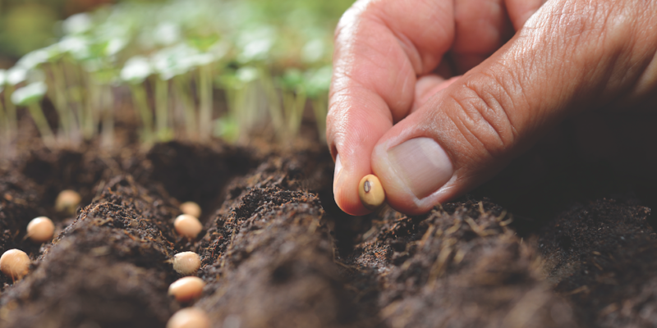
Choosing a Seed
Sortition requires a seed …
Chosen at random
Publicly known
Algorand: new one every round
Cannot be controlled by Adversary

Slide 60
Proposers: seeds & blocks
I propose s_{r}’
I propose s_{r}
Validators adopt seed & block

Slide 61
Soft Vote Phase
Vote for leader with least VRF
old committee
Narrow down to one block & one seed
new committee

Slide 62
Certify Phase
Make sure block is well-formed
old committee
Accept seed along with block

Slide 63
When leaders fail
I propose a bad block
Eventually, s_{r} = H(s_{r-1} || r)
Fall back on standard crypto hash function

Slide 64
Algorand Tokenomics
Parties pledge algos for 3 months
Agree to participate in consensus
OK to delegate vote
Reward at end of 3 month period

Slide 65
Why no Slashing?
Early withdrawal? OK, but no reward
No punishment for bad or lazy behavior
Slashing mechanisms unpopular
Danger of abuse and manipulation

Slide 66

Ethereum

Slide 67
Aye!
Validators
Aye!
Aye!
Vote to
Accept txns
Nay!
Order txns

Slide 68
Me!
PoS Validators
Committee chosen at random
a leader proposes a block
Me!
128 validators confirm block
Committee replaced every 32 blocks

Slide 69
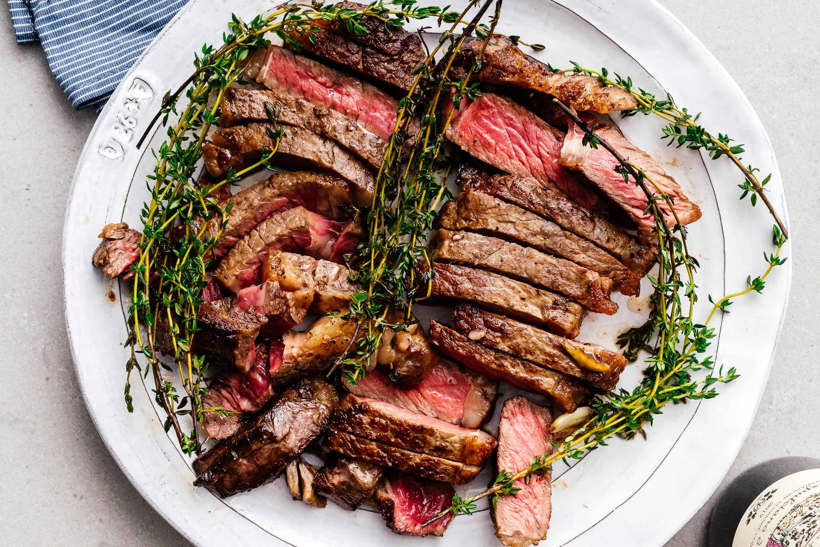
Proof of Stake
PoS resembling Algorand’s
Committee chosen by sortition
But not just everyone can be a validator
Need “skin in the game”

Slide 70

Stake
ETH
ETH
Stake 32 ETH
(~70 K USD March 2025)
To ensure good behavior
lockbox
ETH
ETH

Slide 71
Validators
Stake is slashed for …
Going off-line
lockbox
ETH
ETH
ETH
ETH

Slide 72

Validators
Heh-heh ..
Stake is slashed for …
Going off-line
Confirming bad block
ETH
ETH
ETH
ETH

Slide 73
Finality
checkpoint
checkpoint
checkpoint
block
block
block
block
block
block
block
block
block
epoch
epoch
epoch
time

Slide 74
2/3 vote?
block
block
block
block
block
block
block
block
block
epoch
epoch
epoch
time

Slide 75
2/3 vote?
finalized
justified
block
block
block
block
block
block
block
block
block
epoch
epoch
epoch
time

Slide 76
2/3 vote?
finalized
justified
If finalization stalls for 4 epochs …
block
block
block
block
block
block
block
block
block
epoch
epoch
epoch
Dissenting votes gradually slashed
time
Incentive to behave

Slide 77
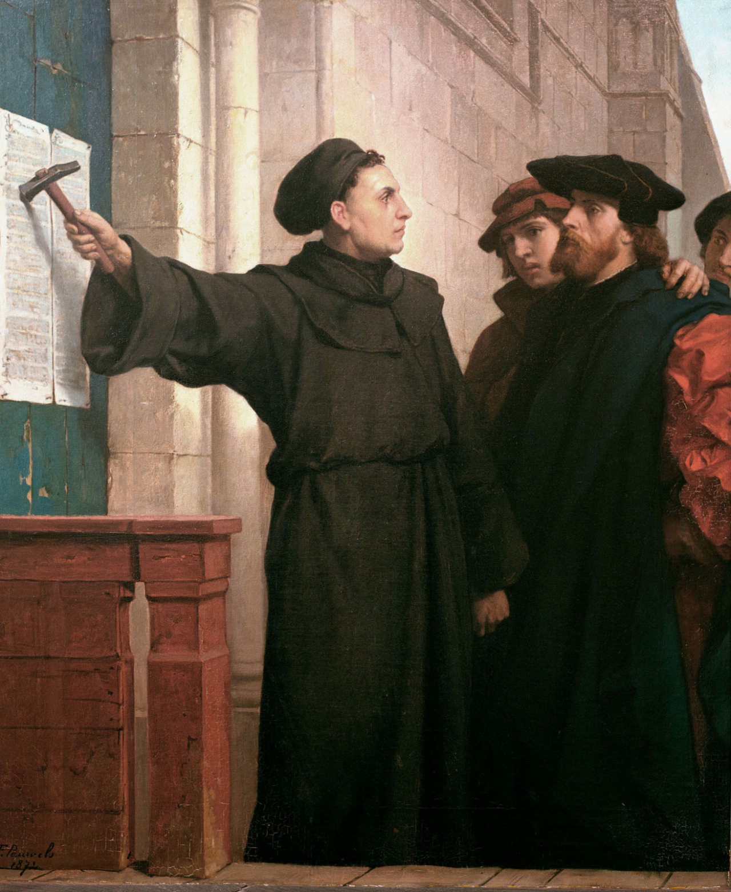
Ideas we covered in this lecture
Proof of stake
Consensus
Verifiable Random Functions
Sortition
PoS in Algorand
PoS in Ethereum

Slide 78
